Slide 1
02: C Pointers & C++ Overloading
Dr. Hamish Carr

Slide 2
Bit Operations
We have seen logical operators
that treat a single quantity as a boolean value
But these use at least 8 bits
when only 1 is needed
And for hardware, you often need 1 bit
packed into, or taken from, an integer
Typically apply to all bits simultaneously

Slide 3
Arithmetic operators
Unary:
~A
Two’s Complement of A
Binary:
A & B
A | B
A ^ B
A << B
A >> B
Bitwise And
Bitwise Or
Bitwise XOr (Exclusive Or)
Left Shift (moves bits to high end)
Right Shift (moves bits to low end)

Slide 4
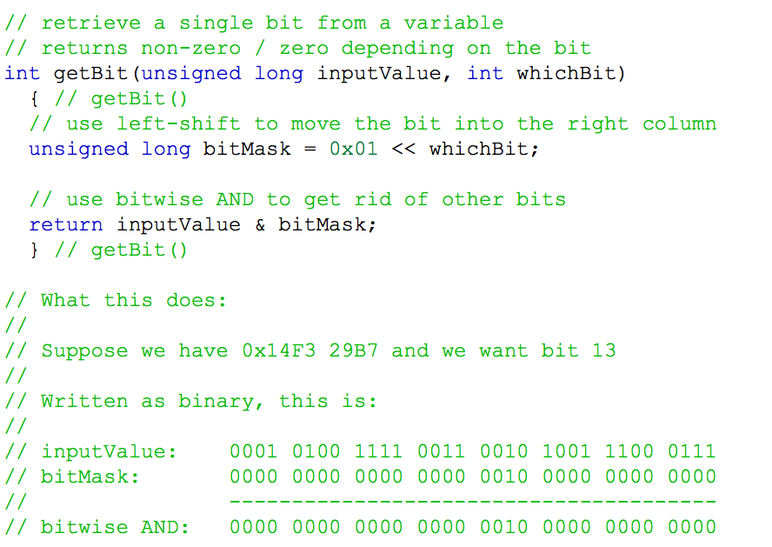
An Example

Slide 5
Static vs. Dynamic Data
We have used fixed size static arrays so far
What if we don’t know how big is enough?
We need dynamic memory allocation
Which means another level of abstraction
Pointers - direct access to memory addresses
The most powerful & dangerous part of C

Slide 6
Variables & Addresses
All variables have a location in memory
We use a name to refer to them
The compiler uses a number - i.e. an address
Every byte has a separate number
i.e. memory is just a huge array of bytes
And a long is just 4 sequential bytes!
A pointer is a variable holding an address

Slide 7
Pointer Declaration
A pointer variable has a type
Which consists of a type and a *
Notice the recursive definition
You can have a pointer to a pointer . . .
long *pointerToLong;
(long **) doublePointerToLong;

Slide 8
Pointer Operations
Two new operators
unary *
unary &
Existing operators
Two functions (in <stdlib.h>)
malloc()
free()

Slide 9
Unary *
How do we use what a pointer points to?
The unary * operator does this
Uses the pointer’s target as the value
Instead of the memory address in the pointer
Can be used in any operation
Including assignment!
So we can change what we point to

Slide 10
Unary &
The unary & retrieves the operand’s address
I.e. it is the opposite of the unary *
We now have multiple meanings for * and &
So be careful you know how this is used
Commonly used for pointer initialisation
But also for function calls

Slide 11
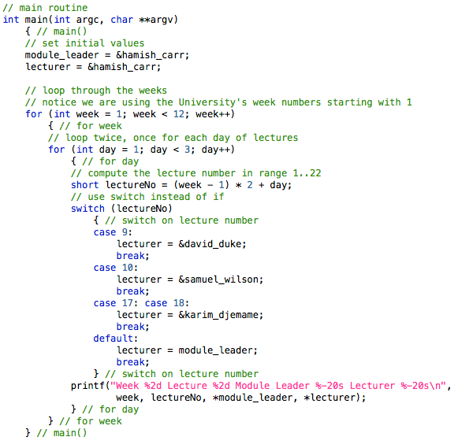
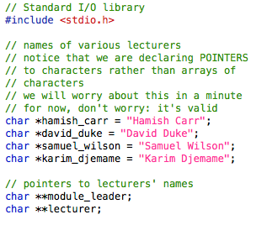
Changing Lecturers

Slide 12
Accessing Array Elements
How do we access array elements?
I.e. what exactly does A[3] mean?
Remember that the computer uses addresses
It has to work out where A[3] is in memory
I.e. A[3] is an operator with two operands:
A is the LHS, 3 is the RHS
The address of A[3] is the (hidden) result

Slide 13
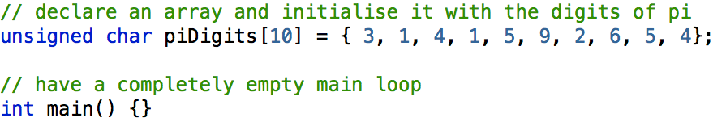
Arrays in Memory
The Code:
Part of Memory (use hex dump at the command line):
1000: 03 01 04 01 05 09 02 06 ........
1008: 05 04 00 00 00 00 00 00 ........
1010: 00 00 00 00 00 00 00 00 ........
piDigit is the name of the array
1000 is the address of the array
(i.e. where it starts in memory)

Slide 14
Finding piDigit[3]
&(piDigit[0]) = piDigit + 0
&(piDigit[1]) = piDigit + 1
&(piDigit[2]) = piDigit + 2
&(piDigit[3]) = piDigit + 3
&(piDigit[4]) = piDigit + 4
&(piDigit[5]) = piDigit + 5
&(piDigit[6]) = piDigit + 6
&(piDigit[7]) = piDigit + 7
&(piDigit[8]) = piDigit + 8
1000: 03
1001: 01
1002: 04
1003: 01
1004: 05
1005: 09
1006: 02
1007: 06
1008: 05
1009: 04
i.e. &(piDigit[i] ) = piDigit + i

Slide 15
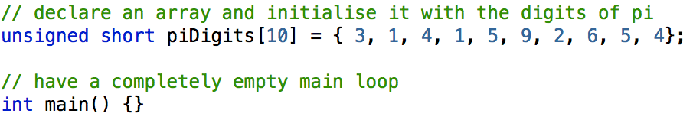
With Short Integers
0001000 03 00 01 00 04 00 01 00 05 00 09 00 02 00 06 00
0001010 05 00 04 00 00 00 00 00 00 00 00 00 00 00 00 00
Each digit now takes 2 bytes
And they are in reverse (little-endian) order
So the computation changes

Slide 16
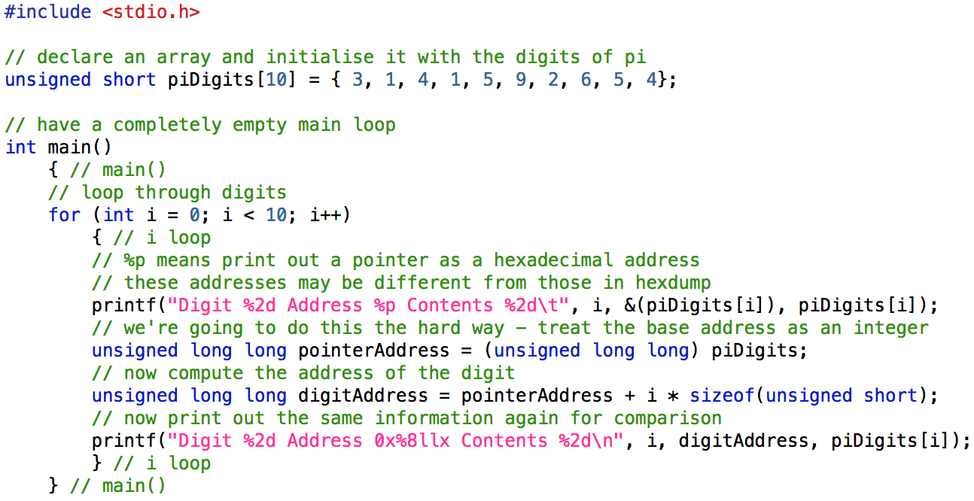
Printing Addresses Out

Slide 17
Output
Digit 0 Address 0x109de1020 Contents 3 Digit 0 Address 0x109de1020 Contents 3
Digit 1 Address 0x109de1022 Contents 1 Digit 1 Address 0x109de1022 Contents 1
Digit 2 Address 0x109de1024 Contents 4 Digit 2 Address 0x109de1024 Contents 4
Digit 3 Address 0x109de1026 Contents 1 Digit 3 Address 0x109de1026 Contents 1
Digit 4 Address 0x109de1028 Contents 5 Digit 4 Address 0x109de1028 Contents 5
Digit 5 Address 0x109de102a Contents 9 Digit 5 Address 0x109de102a Contents 9
Digit 6 Address 0x109de102c Contents 2 Digit 6 Address 0x109de102c Contents 2
Digit 7 Address 0x109de102e Contents 6 Digit 7 Address 0x109de102e Contents 6
Digit 8 Address 0x109de1030 Contents 5 Digit 8 Address 0x109de1030 Contents 5
Digit 9 Address 0x109de1032 Contents 4 Digit 9 Address 0x109de1032 Contents 4
In practice, C knows how to do this
It multiplies by the size of the type
Meaning we can do pointer arithmetic

Slide 18
Pointer Arithmetic
You can apply operators to pointers
pointer ⟵ pointer + integer (or v.v.)
pointer ⟵ pointer - integer
integer ⟵ pointer - pointer
pointer += integer, &c.
pointer++, ++pointer, --pointer, pointer--
+1 means +1*sizeof(type)

Slide 19
Arrays Are Pointers
An array is just a pointer to some memory
With an index operator A[n]
Which is equivalent to A+n
So pointers and arrays are interchangeable
Although compilers now warn you of it
long[] myArray; // unallocated array
long* myPointer; // exactly the same
We’ll leave multi-dimensional arrays alone for now

Slide 20
Initialising Pointers
Pointers are a form of variable
initialise before use
if paranoid, always initialise to:
a special value, NULL, in <stdlib.h>
Guaranteed to be an illegal address
With a predictable error at run-time
A ‘segmentation fault’

Slide 21
Assigning to Pointers
We can assign a literal array to a pointer
char *myName = “Hamish Carr”;
Or we can assign the address of a variable
char *aName = myName;
char **namePointer = &(myName);
Or we can assign the address of a function!
(void *) fPtr = &main;

Slide 22
Allocating Memory
We can ask the system to allocate memory
How does it know the type?
It doesn’t, so it returns a void pointer
And we cast it to our desired type
With malloc() from <stdlib.h>
char *aString = (char *) malloc(10);
We are responsible for any initialisation

Slide 23
malloc() & free()
malloc() allocates bytes of memory
Often for strings or arrays
Calculate the amount using sizeof()
long *myLongs = (long *) malloc(nLongs * sizeof(long));
free() returns the memory to the system
so that it can be reused
Use carefully!

Slide 24
Variable Parameters
Sometimes, a function should change a value
But copying parameters prevents this
Instead, we pass a variable parameter
a pointer to the variable to be changed
Thus, we can’t change the pointer
But we can change the contents
And this is what scanf() uses

Slide 25
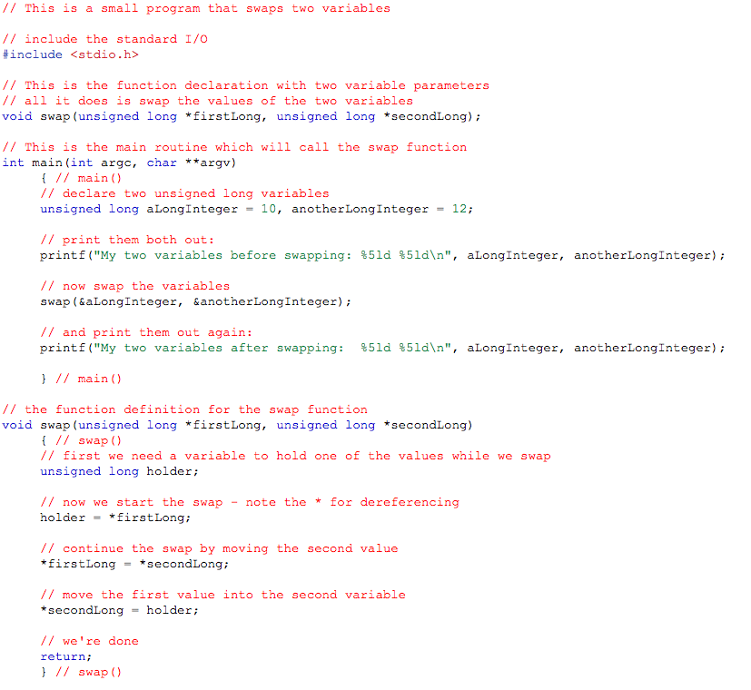
Example

Slide 26
Uses of Pointers
Avoid copying large variables into functions
Allow changing contents of parameters
Allocate memory as/when needed
Deal with varying amounts of input
Build complex internal representations
Of things where ints & floats aren’t enough
Arbitrary manipulation of data

Slide 27
Downsides of Pointers
Memory addresses can be wrong:
Invalid - no memory exists with that address
Illegal - operating system won’t let you
Incorrect - doesn’t point to what you think
Dangling - used to be right, but no longer
Malicious - deliberately wrong for hacking

Slide 28
File I/O
I/O is input & output
A crucial part of working programs
For now, we will ignore GUIs, &c.
And deal only with files on disk
These can be:
ASCII text files
Binary files storing raw info
Structured files (built on top of these two)

Slide 29
Binary Files
Ultimately, all data is just a sequence of bytes
Stored on a disk
So underneath everything is binary read/write
We will look at this first
Then expand to ASCII & structured files

Slide 30
Using Files
When using files, you need to:
1. Specify which file to use (i.e. open the file)
2. Do your reading / writing
a. as ASCII text, or
b. as binary bytes
3. Close your file when done

Slide 31
File Pointers
Files are stored as pointers:
FILE *in_file;
The FILE is a structure (covered later)
It holds all the information the system needs
To find the file on the disk
There are three special file pointers
stdin, stdout, stderr

Slide 32
Opening A File
To open a file, we need to specify:
Where to find the file (the filename)
What type of file we want
The function fopen() does this:
FILE *fopen(char *fileName, char *mode);
And returns a file pointer
If it can’t open the file, it returns NULL

Slide 33
Sample Code
Mode can be:
“r” – read
“w” – write
“a” – append
“b” means binary, but is no longer needed

Slide 34
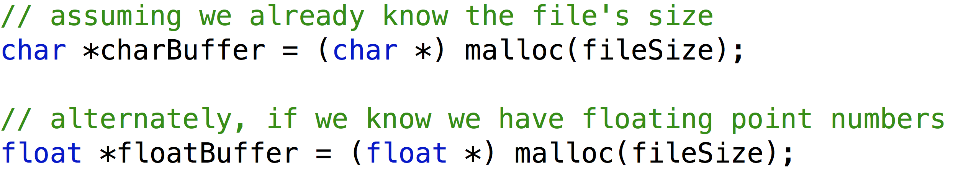
Reading A File
First, you have to have somewhere to store it
Which means allocating memory
So we need to find the file size
Then call malloc() to make sure we have space

Slide 35
Read/Write Head
Notionally, every file has a “read/write head”
Where in the file we’re reading from
Expressed as an offset from the beginning
i.e. a file position
Every time you read or write, it moves
So that it’s always after your last read or write

Slide 36
fseek()
int fseek(FILE *stream, long offset, int whence);
fseek() moves the file position
by the stated offset in bytes
starting from “whence”, which can be:
SEEK_SET: start of the file
SEEK_CUR: current position
SEEK_END: end of the file

Slide 37
ftell() / rewind()
long ftell(FILE *stream);
ftell() tells you the current file position
You pass it the file pointer
It tells you where the file position is
void rewind(FILE *stream);
resets to the start of the file
equivalent to fseek(stream, 0, SEEK_SET);

Slide 38
Finding the File Size
1. Open the file
2. Use fseek() to find the end of the file
3. Use ftell() to get the file position
which is the number of bytes in the file
4 Use rewind() to return to the start of the file

Slide 39
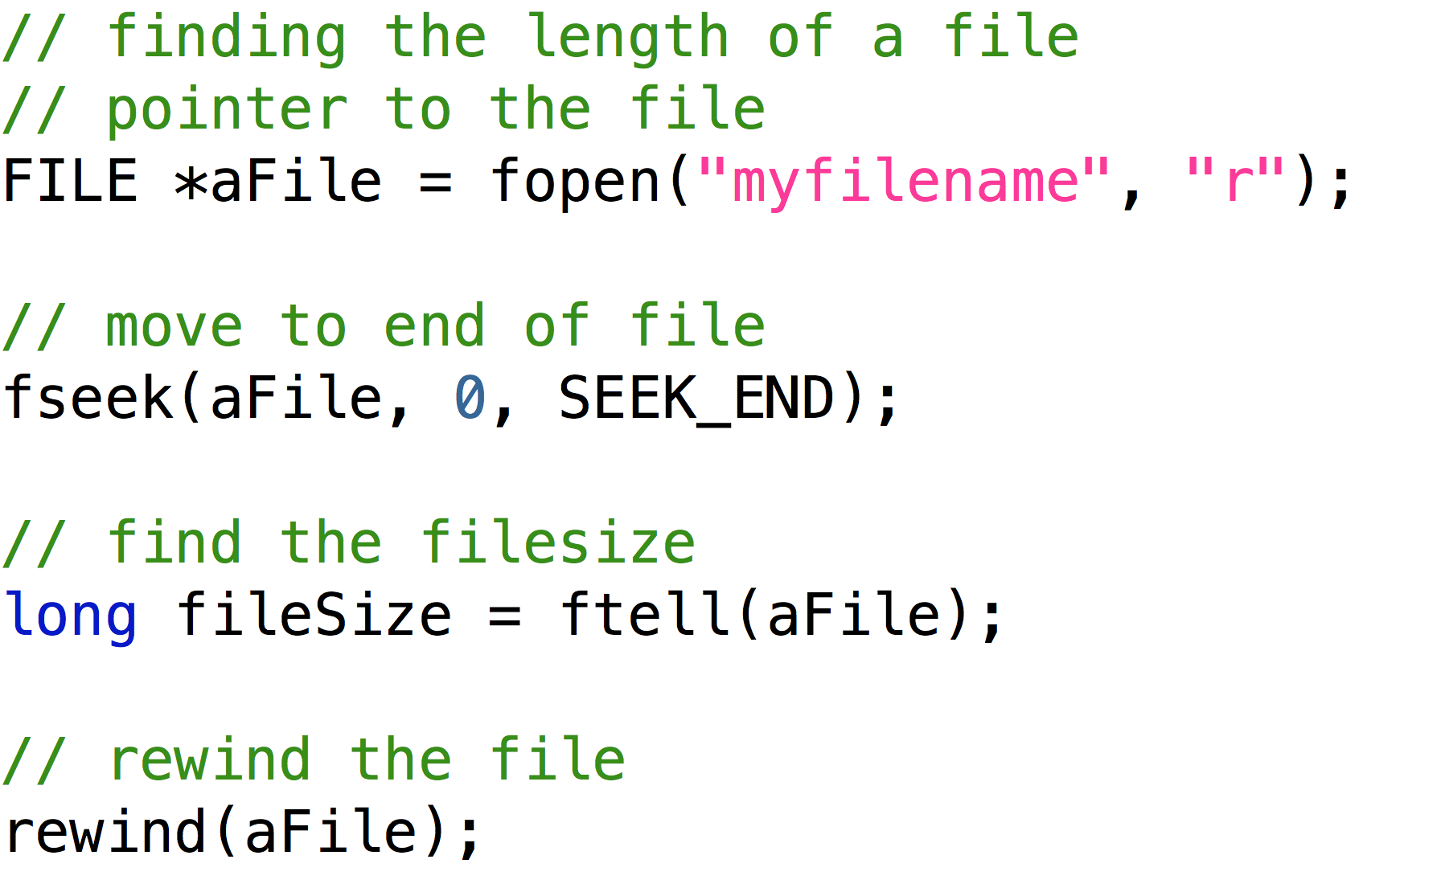
File Size Code

Slide 40
Reading / Writing
size_t fread(void *ptr, size_t size, size_t nitems, FILE *stream);
size_t fwrite(void *ptr, size_t size, size_t nitems, FILE *stream);
ptr is a pointer to the location in memory
size is the size of each item in bytes
nitems is how many items to read
return value is the number of items read

Slide 41
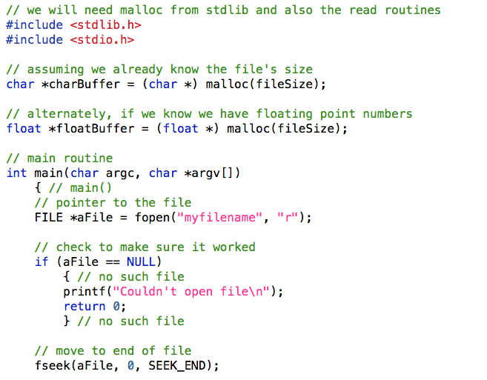
Read Code, I

Slide 42
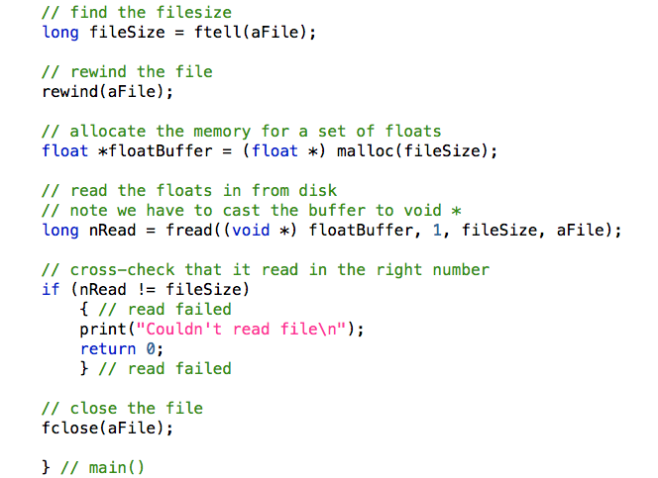
Read Code, II

Slide 43
Matrices in C++
Matrix arithmetic is repetitive
repeated multiplication & addition
ideal for doing on a computer
especially in object-oriented C++
can also do it in Python

Slide 44
C++: Operator Motivation
What if C / Java / C++ had no +-*/= ?
void Assign(int *destination, int source);
int Add(int leftOperand, int rightOperand);
int Subtract( &c., &c., &c.)
// to add 3 & 4 together
// would normally use: x = 3 + 4;
Assign(&x, Add(3, 4));
Painful to use for messy formulas
this is what Java / C do for new types
especially points, vectors & matrices!

Slide 45
C++: Overloaded Operators
C++ allows you to overload operators
i.e. provide new definitions
can even be made member functions
Cartesian3 operator + (Cartesian3 LHS, Cartesian3 RHS);
Return
Type
Function
Name
Parameters (Operands)

Slide 46
Cartesian3 Class (C++)

Slide 47
Cartesian3 Class, II

Slide 48
Cartesian3 Code

Slide 49
Cartesian3 Code, II

Slide 50
Example of Usage

Slide 51
Matrix Class (C++)
class Matrix
{ // class Matrix
public: // makes life easier
float coords[3][3]; // treat each row as a vector
Matrix(); // default constructor
static Matrix Identity(); // returns identity matrix
Vector operator[](int i); // returns a row as a vector
Vector column(int j); // returns a column as vector
} // class Matrix
ostream &operator<< (ostream & ostr, Matrix m)
// C++ print routine

Slide 52
Implementation
Vector Matrix::operator[](int i)
{ // operator[]
return Vector(coords[i][0], coords[i][1], coords[i][2]);
} // operator[]
Vector Matrix::column(int j) // returns a column as vector
{ // column()
return Vector(coords[0][j], coords[1][j], coords[2][j]);
} // column()
ostream &operator<< (ostream & ostr, Matrix m)
{ // print operator
for (int i = 0; i < 3; i++)
ostr << m[i] << endl;
return ostr;
} // print operator

Slide 53
Matrix Addition
Matrix Matrix::operator +(Matrix &left, Matrix &right)
{ // Matrix addition
Matrix resultMatrix;
for (int i = 0; i < 3; i++)
for (int j = 0; j < 3; j++)
resultMatrix[i][j] = left[i][j] + right[i][j];
return resultMatrix;
} // Matrix addition

Slide 54
Matrix * Point or Vector
Point operator* (Matrix m, Point p)
{ // operator*
Point q(0,0,0);
for (int i = 0; i < 3; i++)
for (int j = 0; j < 3; j++)
q[i] += m[i,j] * p[j];
return q;
} // operator*
Vector operator* (Matrix m, Vector v)
{ // operator*
Vector w(0,0,0);
for (int i = 0; i < 3; i++)
w[i] = m[i].Dot(v);
} // operator*

Slide 55
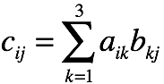
Matrix Multiplication
For entry (i,j), take row i and column j
Multiply their entries and take sum:
Matrix operator* (Matrix A, Matrix B)
{ // operator*
Matrix C;
for (int i = 0; i < 3; i++)
for (int j = 0; j < 3; j++)
{ // i,j
C[i][j] = 0;
for (int k = 0; k < 3; k++)
C[i] += A[i,k] * B[k,j];
return C;
} // operator*

